Slide 1
TAS152
LECTURE 18
TOPIC 3
TOWARDS A JUST INTERNET
3.3 TWO SETS OF VALUES UNDERLYING NEUTRALITY

Slide 2
RECAP
In our previous lecture:
Introduced the concept of net neutrality
Discusses different models for describing the internet
Net neutrality isn't just relevant to the technical aspects, it also refers to how people use and manage the internet
Internet Access Providers (IAP) play a massive role in net neutrality
IAPs have to strike a balance between different demands
Differentiated between the concept of "equality" and "equity"

Slide 3
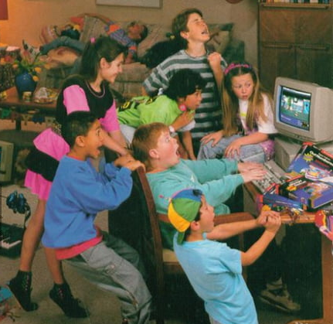
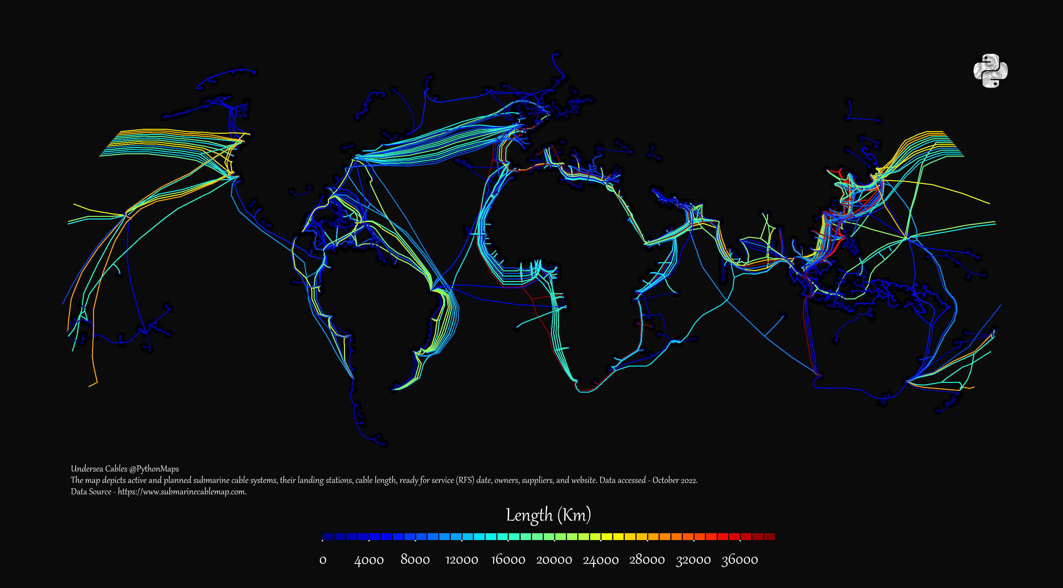
TWO SETS OF VALUES
Values that underpin the freedom of individual Internet users.
Broader values that apply to the Internet as an ecosystem.

Slide 4

VALUES FOR FREEDOM OF INDIVIDUAL INTERNET USERS
The first argument:
Supports neutrality
Two individuals who are in similar situations should receive equal treatment
Their individual rights to create/access info, engage in public debate, or conduct economic activities on the Internet should be protected.
Logical-rational approach (rule-based legal systems)

Slide 5
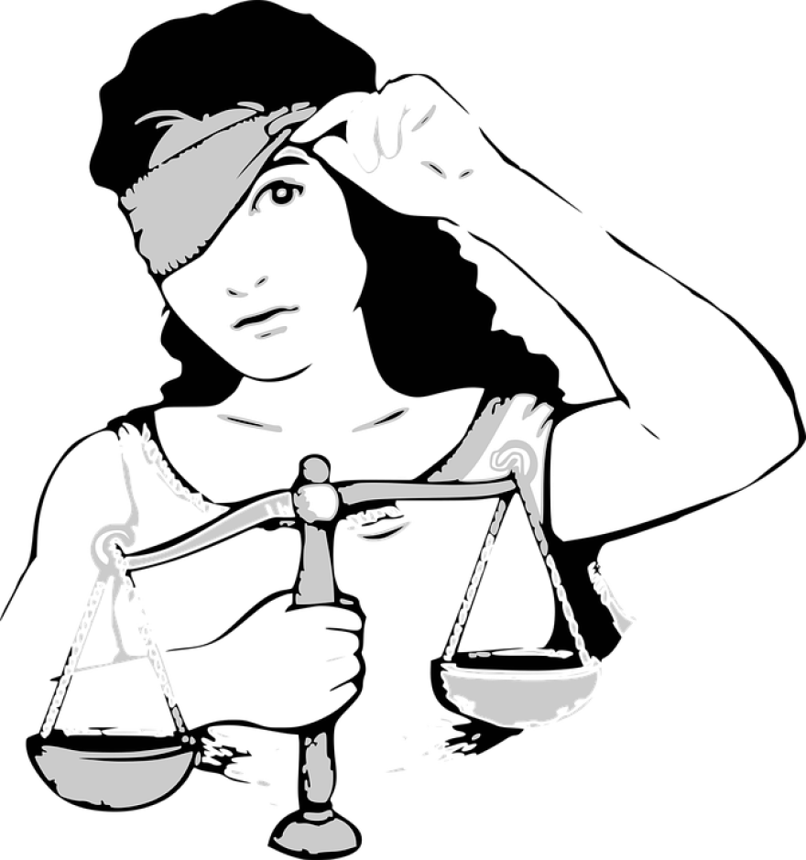
VALUES FOR FREEDOM OF INDIVIDUAL INTERNET USERS
The second argument:
Supports a normative approach (not neutral)
Situation and moral worth of an individual are considered before deciding how they are treated.
Individuals in countries governed by authoritarian regimes need protection to safeguard their rights.

Slide 6
VALUES FOR THE BROADER ROLE OF THE INTERNET
The role of the Internet within the ‘informational ecosystem’
Four key principles:
Entropy should not be caused
Entropy should be prevented
Entropy should be removed (Entropy = anything that results in information being lost)
Information is promoted by extending, improving, enriching and opening the infosphere, that is by ensuring information quantity, quality, variety, security, ownership, privacy, pluralism and access
(Information should be preserved and accessible.)

Slide 7
VALUES FOR THE BROADER ROLE OF THE INTERNET
What is the overall meaning of these principles?
Net neutrality should only happen if no damage will be inflicted on the existing/diverse global information environment.

